Slide 1
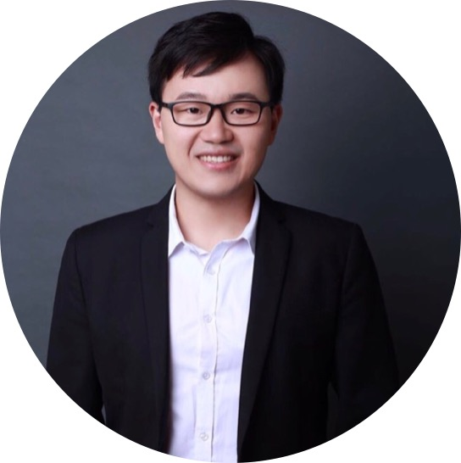
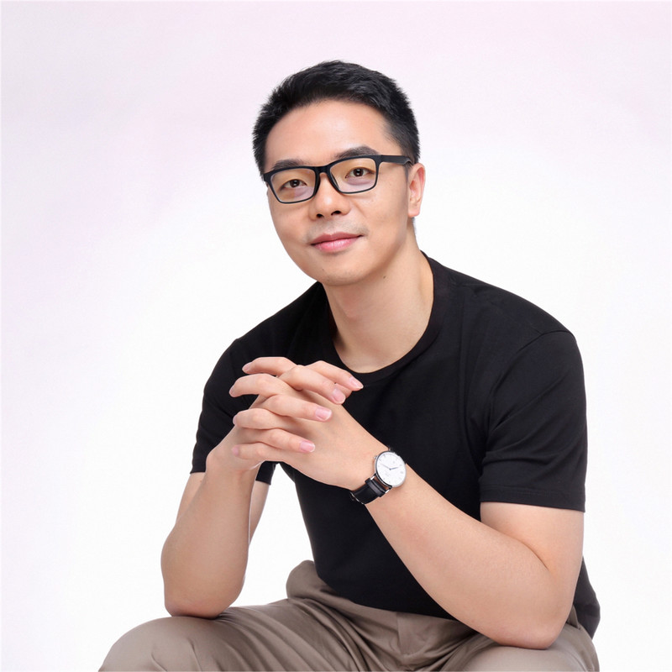
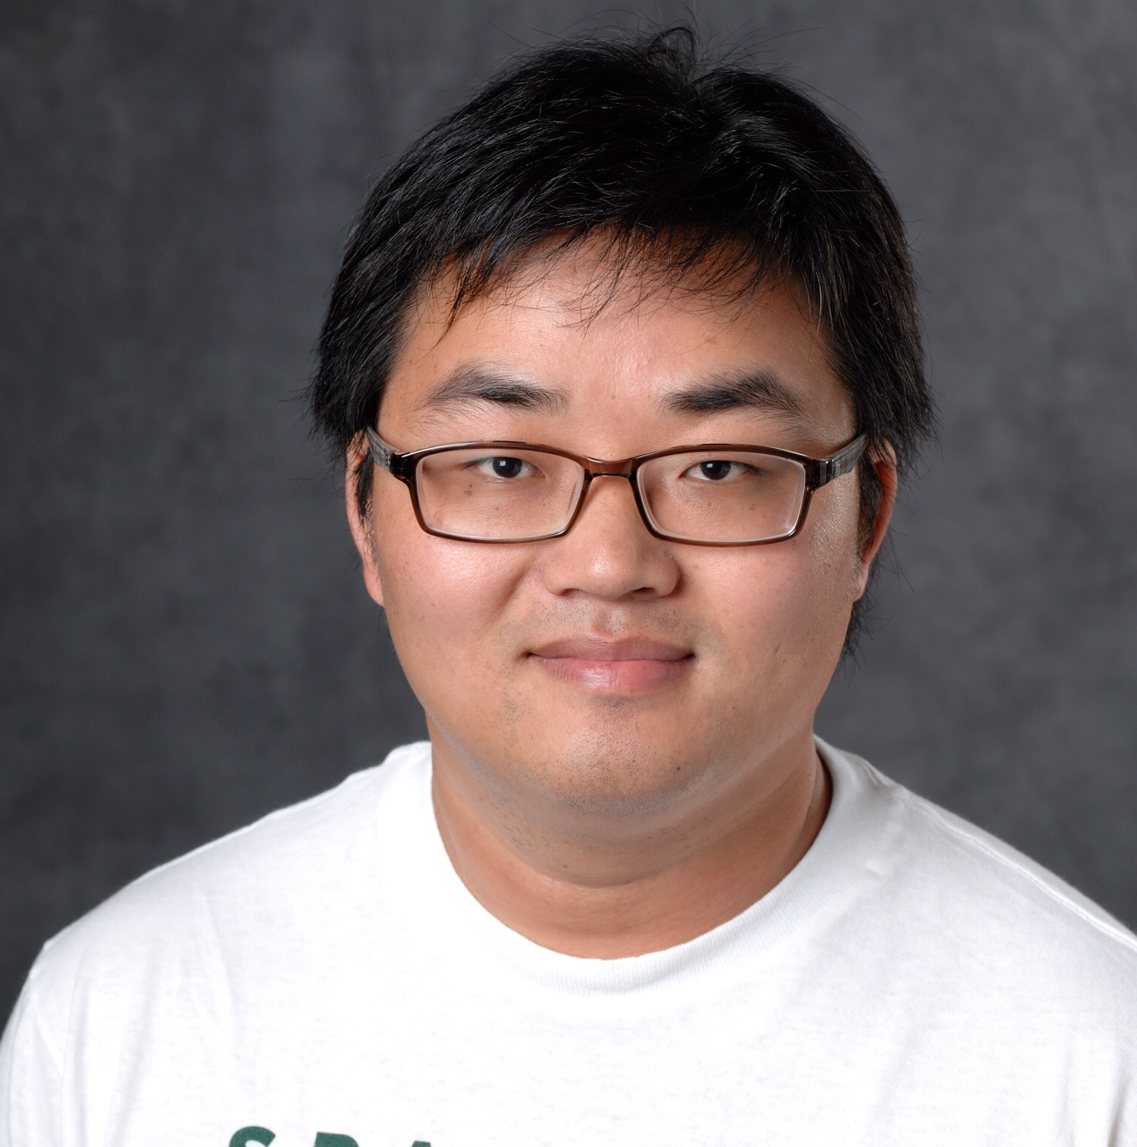
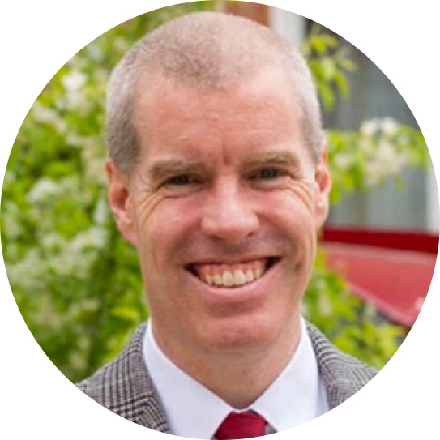
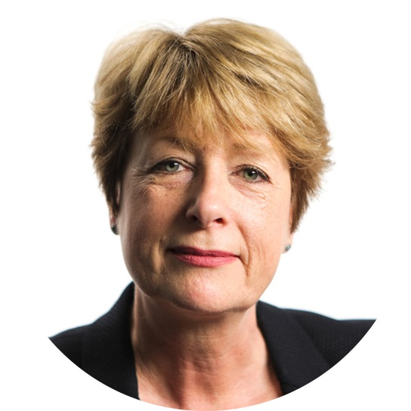
Zitao
Liu
Songfan
Yang
Jiliang
Tang
Neil
Heffernan
Rose
Luckin

Slide 2
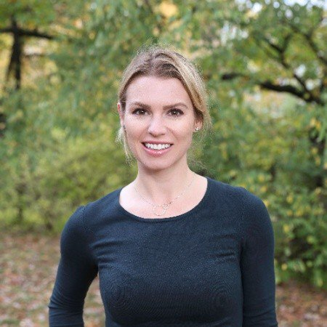
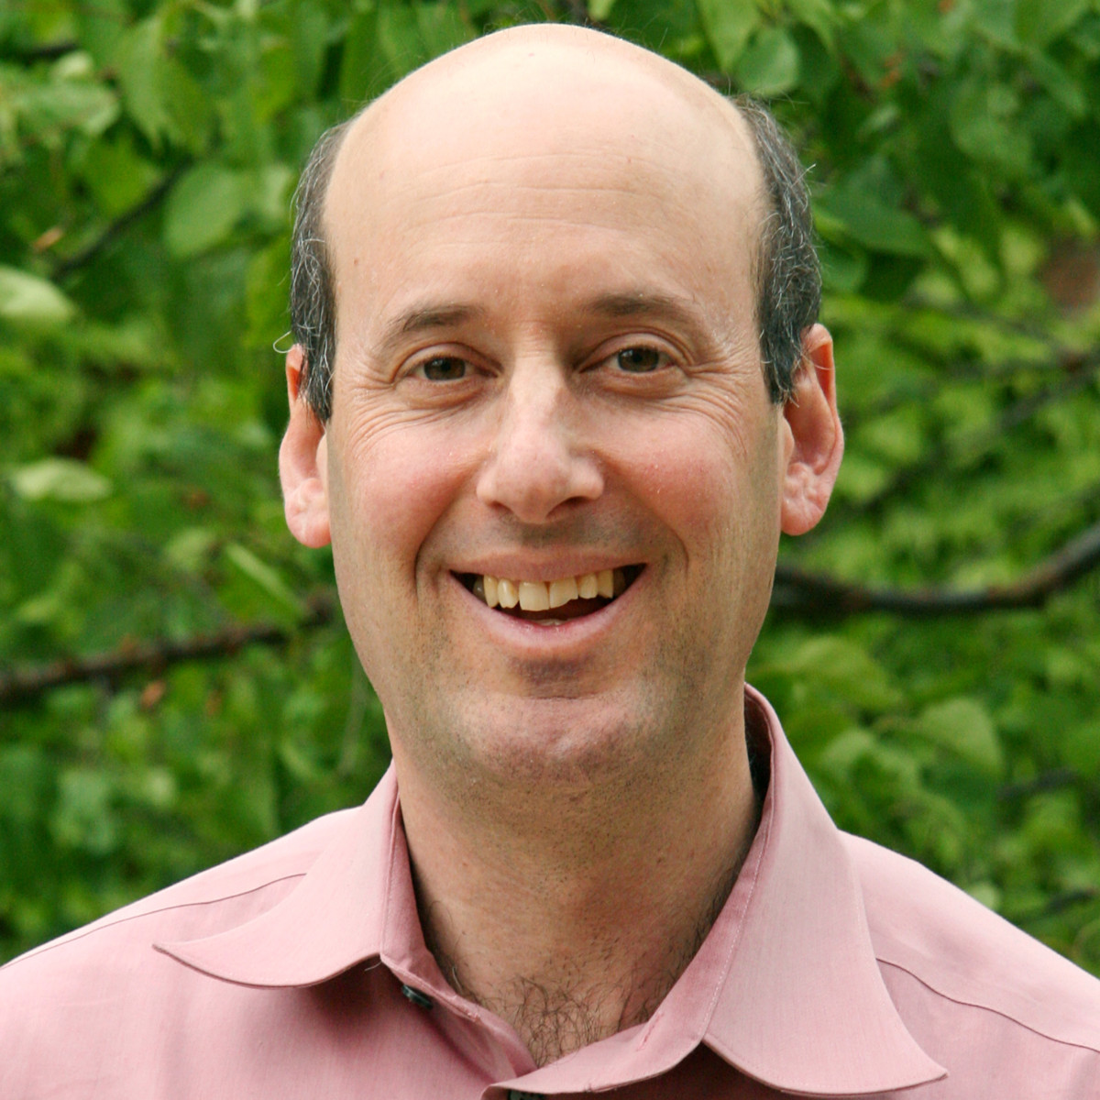
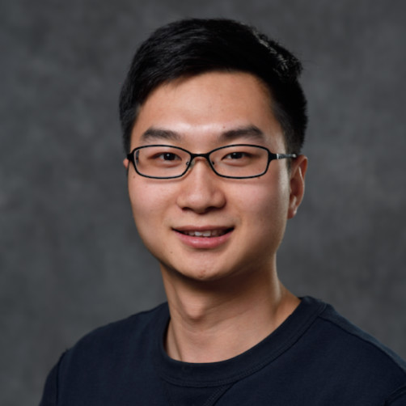
Jiliang
Tang
Zitao
Liu
Kaitlin
Torphy
Kenneth
Frank
Zhiwei
Wang

Slide 3
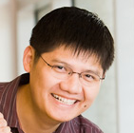
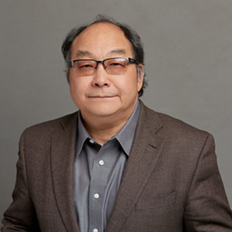
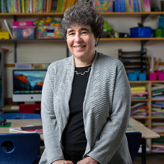
Zitao
Liu
Jiliang
Tang
Yi
Chang
Xiangen
Hu
Diane
Litman

Slide 4
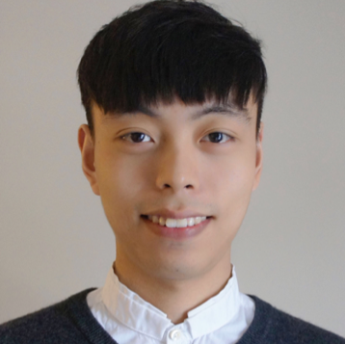
Zitao
Liu
Richard
Tong
Jiliang
Tang
Xiangen
Hu
Hang
Li

Slide 5
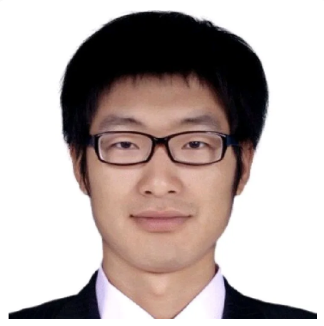
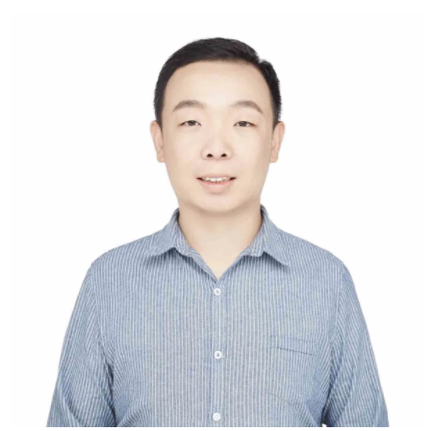
Zitao
Liu
Jiliang
Tang
Lihan
Zhao
Xiao
Zhai

Slide 6
Zitao
Liu
Richard
Tong
Jiliang
Tang
Xiangen
Hu
Hang
Li

Slide 7
